Slide 1
交接文件
AID

Slide 2
目錄
AID 相關實作
OurChain 相關實作
其它嘗試

Slide 3
AID 相關

Slide 4
AID System
User
Service

Slide 5
AID System (Type1)
Client Application
Server Application
Wallet Lib
Service SDK

Slide 6
AID System (Type2)
AID Server
Client Application
Server Application
Wallet Lib
Service SDK

Slide 7
AID System (Type3)
Smart Contract
Client Application
Server Application
Wallet Lib
Service SDK

Slide 8
AID System (Type4)
Smart Contracts
AID Server
(大流量)
Client Application
Server Application
Wallet Lib
Service SDK

Slide 9
Type3 vs Type4
Smart contract
UUID
AID
Hash
UUID
AID
Hash
UUID
AID
Hash

Slide 10
Type3 vs Type4
Smart contract
Smart contract
Smart contract
UUID
UUID
UUID
AID
AID
AID
Hash
Hash
Hash
AID Server
AID Server

Slide 11
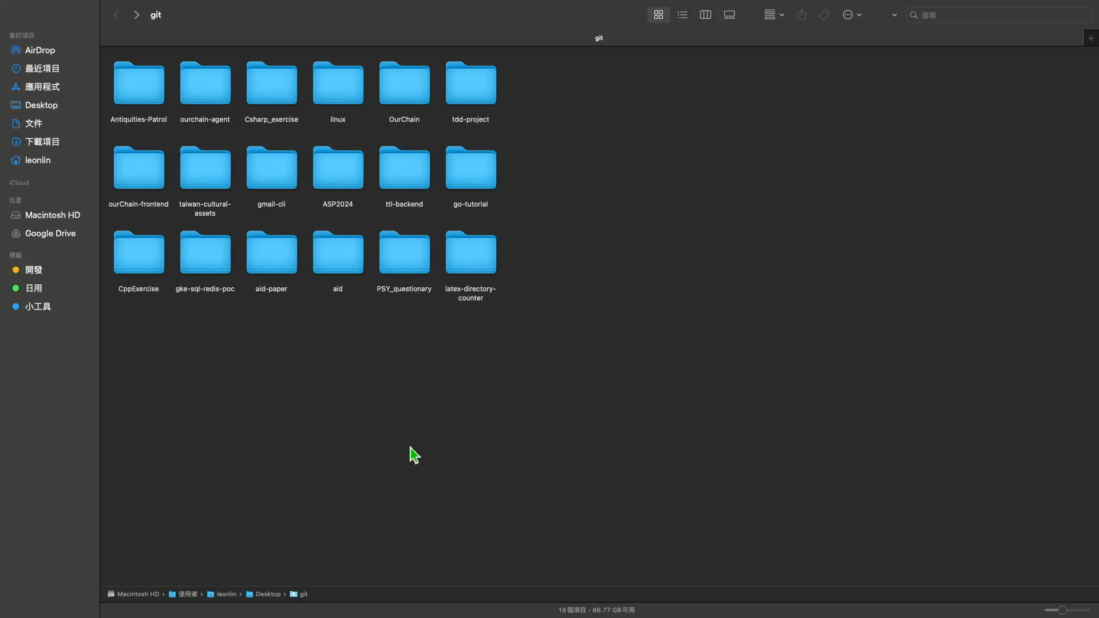
DEMO
Url: github leon123858/aid/demo/t1
Docker compose up

Slide 12
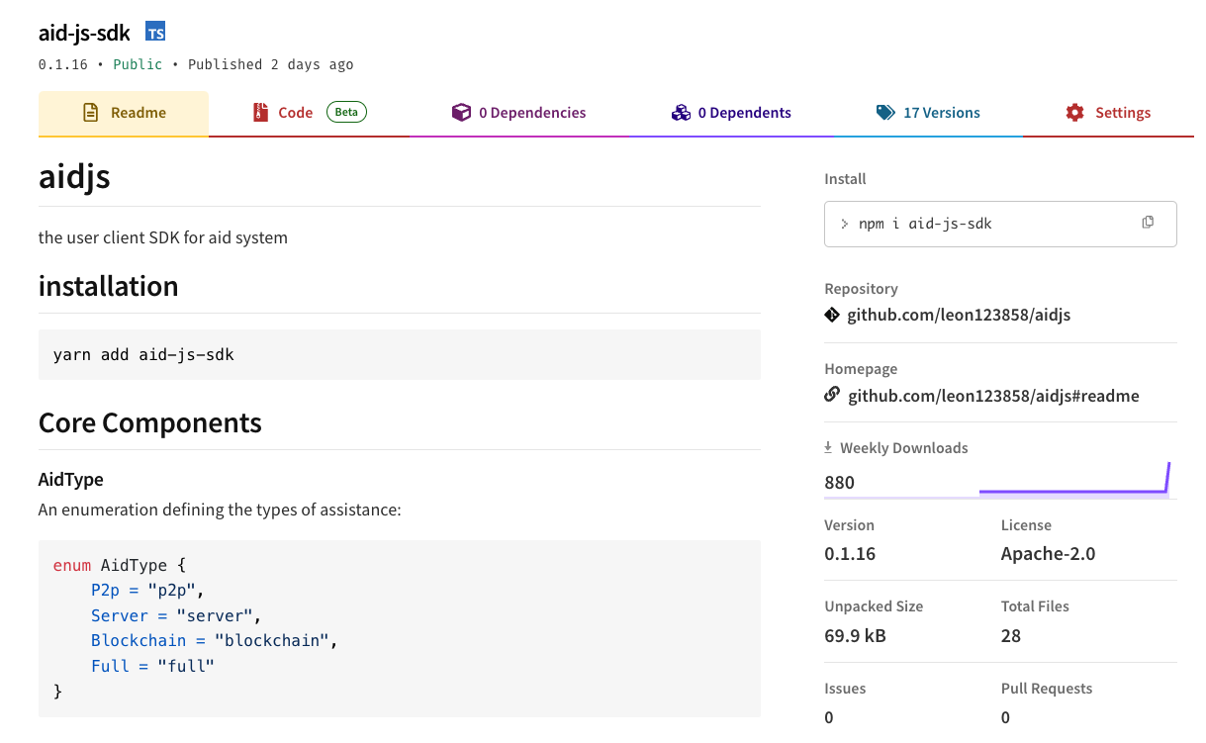
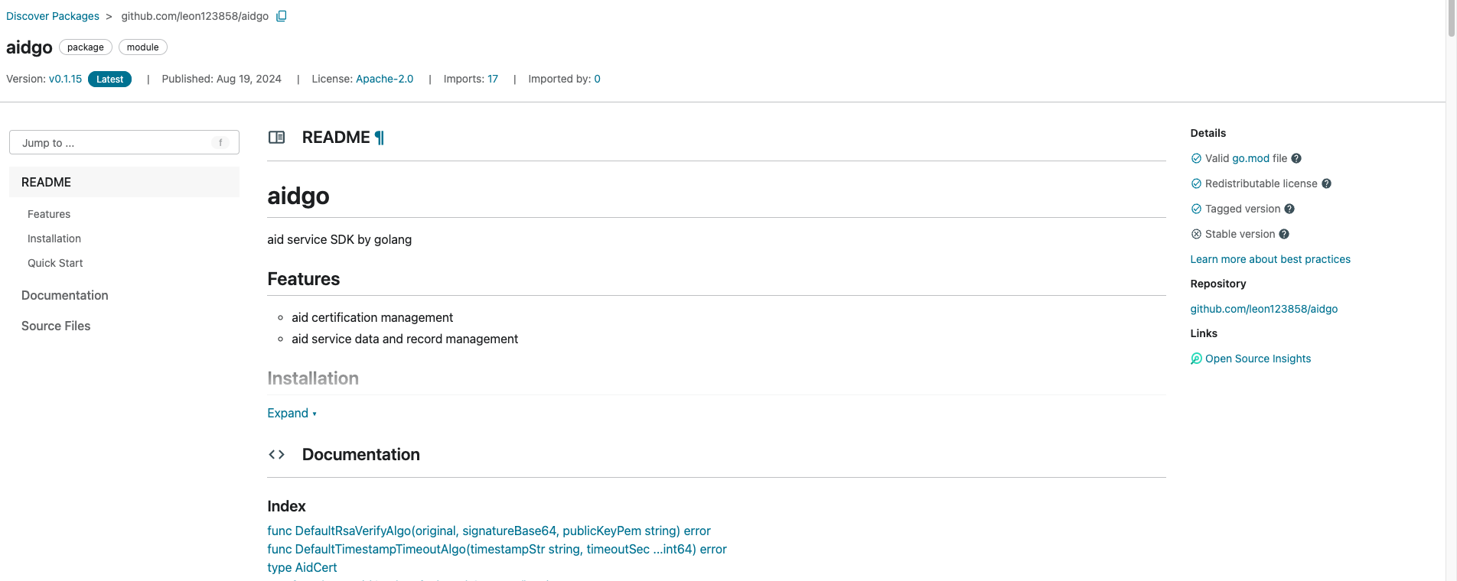
如何下載
Frontend SDK: https://www.npmjs.com/package/aid-js-sdk
Backend SDK: https://pkg.go.dev/github.com/leon123858/aidgo
AID Server: https://github.com/leon123858/aid/tree/main/aid-server

Slide 13
實作案例
AID Type1 Demo: https://github.com/leon123858/aid/tree/main/demo/t1
AID Type2 Demo: https://github.com/leon123858/aid/tree/main/demo/t2
AID Type3 Demo: https://github.com/leon123858/aid/tree/main/demo/t3

Slide 14
OurChain 相關

Slide 15
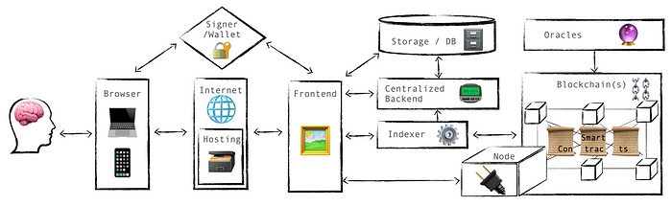
Dapp 架構
Ref: https://medium.com/@blocktorch/architecture-of-decentralized-applications-dapps-d583db198a6f

Slide 16


OurChain 缺了什麼 ?

Slide 17
BitcoinV0.15 vs OurChain
Node
BitcoinV0.15
GUI
RPC
Wallet
CLI
Scanner
+
Proxy
Node
OurChain Now
Wallet CLI/GUI
Rest
agent
RPC

Slide 18
REF Explain
Bitcoin With No Wallet:
https://github.com/btcsuite/btcd
Simplified Payment Verification Wallet (SPV) :
https://github.com/btcsuite/btcwallet
Bcoin: https://github.com/bcoin-org/bcoin
Full Node
SPV Node
Wallet Backend
Mining Backend (getblocktemplate support)
Layer 2 Backend (lightning)
General Purpose Bitcoin Library
SPV
Bitcoin
(reconstructed)

Slide 19
Reconstructed OurContract
Quicker: 優化整體流程，優化冗余IO, 強化平行能力
Smarter: 追蹤合約狀態，依照區塊高度變化，清除或跟進狀態
More Feature: 更多好用的合約函數
3
4
2
2
2
Origin: 1 => 2 => 3 => 4
Now: 1 => 2 => 4
1
1
1

Slide 20
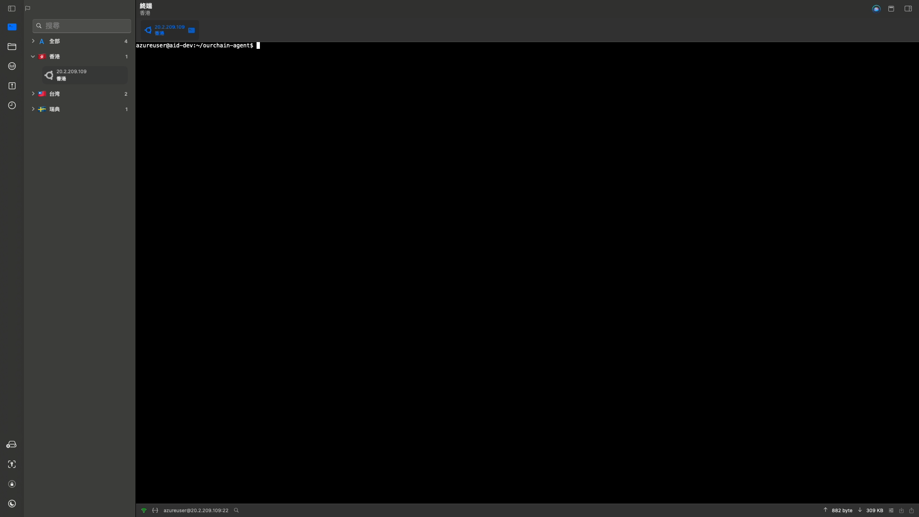
DEMO
Url: https://github.com/leon123858/ourchain-agent
docker compose up

Slide 21
Source Code
OurChain: https://github.com/leon123858/OurChain
Agent: https://github.com/leon123858/ourchain-agent
Wallet: 詳見 agent 文件
Wallet
agent
OurChain
Rest
RPC
Single machine

Slide 22
其它嘗試

Slide 23
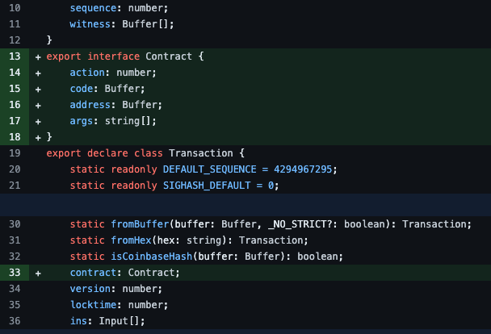
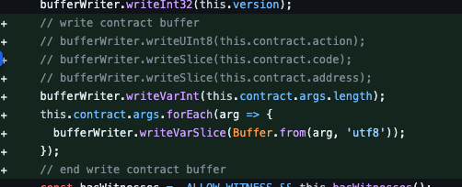
Ourchainjs-lib
Src: https://github.com/leon123858/ourchainjs-lib
基於 bitcoinjs-lib，目前尚未實作完成
在移動設備
完成 Wallet 各種編碼簽章操作

Slide 24
rpc-OurChain
Src: https://github.com/leon123858/rpc-OurChain
調用 bitcoin 的 SDK 改的
宣告沒有用，只適合用在 local 調用 local 的場景
因為其不包含錢包邏輯

Slide 25
OurCoin
Src: https://github.com/leon123858/OurCoin
利用 bcoin 製作的 JS 版 OurChain
具有許多 SPV 需要的功能，因為 bcoin 已經實作
棄用：
因為 bcoin 是為了錢包而製作，在效能與機制上有許多權衡
但 OurChain 還要考慮其他的目的
在只能做一個的前提下，優先改原來的版本

Slide 26
OurChain-frontend
Src: https://github.com/leon123858/ourChain-frontend
串接各個版本 OurChain 的前端應用 Demo，目前較具有參考價值的僅
https://github.com/leon123858/ourChain-frontend/tree/main/ourchain-web-cli
https://github.com/leon123858/ourChain-frontend/tree/main/our-wallet-app

Slide 27
相關連結統整

Slide 28
AID
SDK
https://github.com/leon123858/aidgo
https://github.com/leon123858/aidjs
AID Server and Demo
https://github.com/leon123858/aid

Slide 29
OurChain
Core
https://github.com/leon123858/OurChain
https://github.com/leon123858/ourchain-agent
Others
https://github.com/leon123858/ourchainjs-lib
https://github.com/leon123858/OurCoin
https://github.com/leon123858/rpc-OurChain
https://github.com/leon123858/ourChain-frontend

